Slide 1
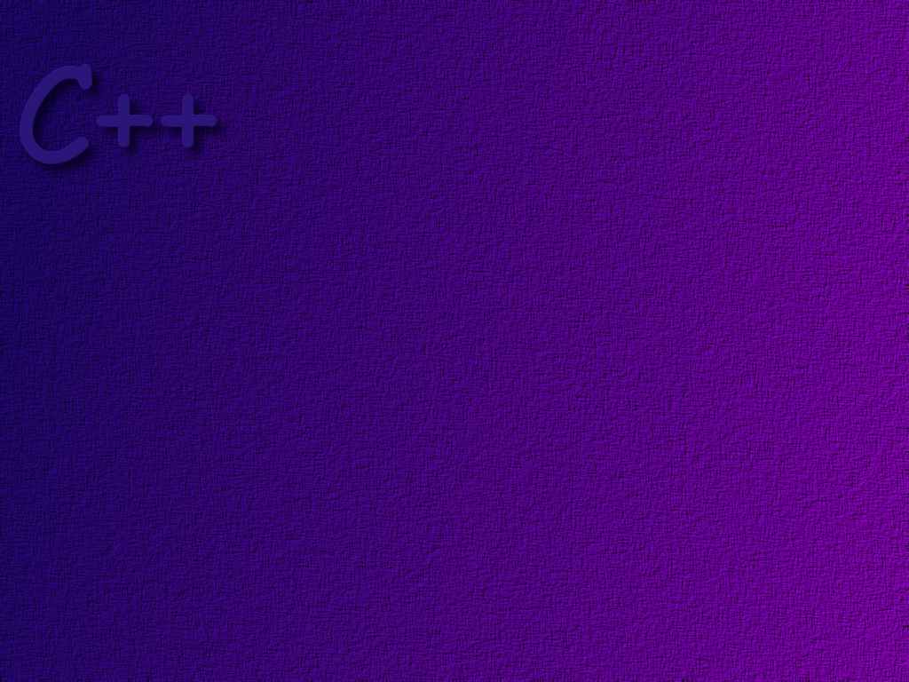
CNS 1410
Graphical User Interfaces

Slide 2
Obectives
Students should understand the difference between
a procedural program and an Event Driven Program.
Students should be able to describe the basic components of a GUI.
Students should be able to create a simple GUI, using wxWidgets
Students should be able to describe the event handling mechanism of
wxWidgets.

Slide 3
Traditional Model – Command Line Programs
main ( )
{
declare variables
create objects
send messages to objects
. . .
send messages to objects
. . .
return 0
}
Object
Object

Slide 4
Graphical User Interface Model
Frame
Object
Application
Object
Domain
Objects

Slide 5
Graphical User Interface Model
The application object “listens”
for events to occur, then calls
event handlers in the Frame
Object.
Application
Object

Slide 6
Graphical User Interface Model
GUI
Component
Frame
Object
GUI
Component
Event handlers react
to events
GUI
Component
GUI Component (widgets)
generate events.

Slide 7
GUI Components
x
File Edit View Help
Name:
Phone:
Frame
PUSH

Slide 8
Graphical User Interface Model
Domain objects
do the work of
the application
Domain
Objects

Slide 9

File Edit View Help
Application
Object
Button
Event
PUSH
Windows
Event Queue

Slide 10
Frame
Object
Application
Object
Button
Event
Windows
Event Queue

Slide 11
Frame
Object
Application
Object
Call event handler
Button
Event
Windows
Event Queue

Slide 12
Graphical User Interfaces
Frame
Object
Application
Object
Call event handler
Button
Event
Call functions in
domain objects
to do some work.
Domain
Objects
Windows
Event Queue

Slide 13
The application class only needs one
Function named OnInit. This function
is used to create the User Interface.
Application
Object
#include <wx/wx.h>
class BasicApplication : public wxApp
{
public:
bool OnInit( );
};

Slide 14
bool BasicApplication::OnInit( )
{
BasicFrame *frame = new BasicFrame("Hello World", 50, 50, 450, 340);
frame->Show(true);
SetTopWindow(frame);
return TRUE;
}
This statement creates a Frame object. Frames
represent windows. By default, Frame objects
contain all of the function of a simple window.
You can drag them, resize them, and close them.

Slide 15
bool BasicApplication::OnInit( )
{
BasicFrame *frame = new BasicFrame("Hello World", 50, 50, 450, 340);
frame->Show(true);
SetTopWindow(frame);
return TRUE;
}
This statement makes the Frame object visible.

Slide 16
bool BasicApplication::OnInit( )
{
BasicFrame *frame = new BasicFrame("Hello World", 50, 50, 450, 340);
frame->Show(true);
SetTopWindow(frame);
return TRUE;
}
This statement makes the Frame the topmost
Frame.

Slide 17
#include <wx/wx.h>
class BasicFrame : public wxFrame
{
public:
BasicFrame(const wxChar *title, int xpos, int ypos,
int width, int height);
void OnQuit(wxCommandEvent& event);
void OnAbout(wxCommandEvent& event);
private:
DECLARE_EVENT_TABLE( )
};
Event handlers

Slide 18
The Event Table for the Frame
BEGIN_EVENT_TABLE(BasicFrame, wxFrame)
EVT_MENU(ID_QUIT, BasicFrame::OnQuit)
EVT_MENU(ID_ABOUT, BasicFrame::OnAbout)
END_EVENT_TABLE( )
When you receive an event named ID_QUIT, call the
function OnQuit in the BasicFrame class.

Slide 19
Frame Constructor
Position of upper left
hand corner of the
window on the screen
text for title bar
BasicFrame::BasicFrame(const wxChar *title, int xpos, int ypos,
int width, int height)
: wxFrame( (wxFrame *)NULL, -1, title, wxPoint(xpos, ypos),
wxSize(width, height))
{
wxMenu *menuFile = new wxMenu;
menuFile->Append(ID_ABOUT, "&About...");
menuFile->AppendSeparator( );
menuFile->Append(ID_QUIT, "E&xit");
wxMenuBar *menuBar = new wxMenuBar;
menuBar->Append(menuFile, "&File");
SetMenuBar(menuBar);
CreateStatusBar( );
SetStatusText("Welcome to wxWidgets");
}
window size

Slide 20
Frame Constructor
ID – default is -1
pointer to parent (containing) class
title bar text
BasicFrame::BasicFrame(const wxChar *title, int xpos, int ypos,
int width, int height)
: wxFrame( (wxFrame *)NULL, -1, title, wxPoint(xpos, ypos), //
wxSize(width, height))
{
wxMenu *menuFile = new wxMenu;
menuFile->Append(ID_ABOUT, "&About...");
menuFile->AppendSeparator( );
menuFile->Append(ID_QUIT, "E&xit");
wxMenuBar *menuBar = new wxMenuBar;
menuBar->Append(menuFile, "&File");
SetMenuBar(menuBar);
CreateStatusBar( );
SetStatusText("Welcome to wxWidgets");
}
position
// size

Slide 21
Frame Constructor
BasicFrame::BasicFrame(const wxChar *title, int xpos, int ypos,
int width, int height)
: wxFrame( (wxFrame *)NULL, -1, title, wxPoint(xpos, ypos),
wxSize(width, height))
{
wxMenu *menuFile = new wxMenu;
menuFile->Append(ID_ABOUT, "&About...");
menuFile->AppendSeparator( );
menuFile->Append(ID_QUIT, "E&xit");
wxMenuBar *menuBar = new wxMenuBar;
menuBar->Append(menuFile, "&File");
SetMenuBar(menuBar);
CreateStatusBar( );
SetStatusText("Welcome to wxWidgets");
}
create a menu object

Slide 22
Frame Constructor
BasicFrame::BasicFrame(const wxChar *title, int xpos, int ypos,
int width, int height)
: wxFrame( (wxFrame *)NULL, -1, title, wxPoint(xpos, ypos),
wxSize(width, height))
{
wxMenu *menuFile = new wxMenu;
menuFile->Append(ID_ABOUT, "&About...");
menuFile->AppendSeparator( );
menuFile->Append(ID_QUIT, "E&xit");
wxMenuBar *menuBar = new wxMenuBar;
menuBar->Append(menuFile, "&File");
SetMenuBar(menuBar);
CreateStatusBar( );
SetStatusText("Welcome to wxWidgets");
}
generate an event with this name
Define the menu
items in the menu
About
Exit

Slide 23
Frame Constructor
BasicFrame::BasicFrame(const wxChar *title, int xpos, int ypos,
int width, int height)
: wxFrame( (wxFrame *)NULL, -1, title, wxPoint(xpos, ypos),
wxSize(width, height))
{
wxMenu *menuFile = new wxMenu;
menuFile->Append(ID_ABOUT, "&About...");
menuFile->AppendSeparator( );
menuFile->Append(ID_QUIT, "E&xit");
wxMenuBar *menuBar = new wxMenuBar;
menuBar->Append(menuFile, "&File");
SetMenuBar(menuBar);
CreateStatusBar( );
SetStatusText("Welcome to wxWidgets");
}
Define a MenuBar object

Slide 24
Frame Constructor
BasicFrame::BasicFrame(const wxChar *title, int xpos, int ypos,
int width, int height)
: wxFrame( (wxFrame *)NULL, -1, title, wxPoint(xpos, ypos),
wxSize(width, height))
{
wxMenu *menuFile = new wxMenu;
menuFile->Append(ID_ABOUT, "&About...");
menuFile->AppendSeparator( );
menuFile->Append(ID_QUIT, "E&xit");
wxMenuBar *menuBar = new wxMenuBar;
menuBar->Append(menuFile, "&File");
SetMenuBar(menuBar);
CreateStatusBar( );
SetStatusText("Welcome to wxWidgets");
}
Store the Menu object in the
MenuBar and label it.
File
About
Quit

Slide 25
Frame Constructor
BasicFrame::BasicFrame(const wxChar *title, int xpos, int ypos,
int width, int height)
: wxFrame( (wxFrame *)NULL, -1, title, wxPoint(xpos, ypos),
wxSize(width, height))
{
wxMenu *menuFile = new wxMenu;
menuFile->Append(ID_ABOUT, "&About...");
menuFile->AppendSeparator( );
menuFile->Append(ID_QUIT, "E&xit");
wxMenuBar *menuBar = new wxMenuBar;
menuBar->Append(menuFile, "&File");
SetMenuBar(menuBar);
CreateStatusBar( );
SetStatusText("Welcome to wxWidgets");
}
Make the MenuBar object the
currently active menu bar.

Slide 26
Frame Constructor
BasicFrame::BasicFrame(const wxChar *title, int xpos, int ypos,
int width, int height)
: wxFrame( (wxFrame *)NULL, -1, title, wxPoint(xpos, ypos),
wxSize(width, height))
{
wxMenu *menuFile = new wxMenu;
menuFile->Append(ID_ABOUT, "&About...");
menuFile->AppendSeparator( );
menuFile->Append(ID_QUIT, "E&xit");
wxMenuBar *menuBar = new wxMenuBar;
menuBar->Append(menuFile, "&File");
SetMenuBar(menuBar);
CreateStatusBar( );
SetStatusText("Welcome to wxWidgets");
}
Create a StatusBar object

Slide 27
Frame Constructor
BasicFrame::BasicFrame(const wxChar *title, int xpos, int ypos,
int width, int height)
: wxFrame( (wxFrame *)NULL, -1, title, wxPoint(xpos, ypos),
wxSize(width, height))
{
wxMenu *menuFile = new wxMenu;
menuFile->Append(ID_ABOUT, "&About...");
menuFile->AppendSeparator( );
menuFile->Append(ID_QUIT, "E&xit");
wxMenuBar *menuBar = new wxMenuBar;
menuBar->Append(menuFile, "&File");
SetMenuBar(menuBar);
CreateStatusBar( );
SetStatusText("Welcome to wxWidgets");
}
Store this text in the status bar

Slide 28
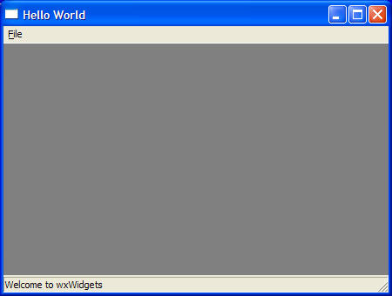

Slide 29
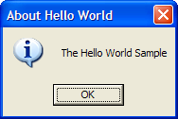
The Event Handlers
void BasicFrame::OnQuit(wxCommandEvent& event)
{
Close(TRUE);
}
void BasicFrame::OnAbout(wxCommandEvent& event)
{
wxMessageBox("The Hello World Sample",
"About Hello World", wxOK |
wxICON_INFORMATION);
}
Closes the window and terminates the application.

Slide 30
Finishing Touches
enum
{
ID_QUIT = 1,
ID_ABOUT
};
Use an enumeration to define event names
IMPLEMENT_APP(BasicApplication)
This macro starts the Windows event loop running

Slide 31
Write the code using the minGW Compiler
This code is available on the course
web site as part of Lab #5.

